Slide 1

House Price Prediction
Arjun Kale 210943025005
Shubham Khanpate 210943025048
Amol Dhole 210943025011
Sujit Kokate 210943025050
Guided by:
Sanjay Sane
Amey Manjrekar

Slide 2
Overview
Introduction
Problem Statement
Dataset
Project Life Cycle
Data Import
Feature Engineering
Models Selection
Result
Visualization
UI based Website

Slide 3
Introduction
Every single organization in today’s real estate business is operating fruitfully to achieve a competitive edge over alternative competitors.
There is a need to simplify the process for a normal human being while providing the best results.
In this project, we have built machine learning model to predict the house price.
This proposes a system that predicts house prices using a regression machine learning algorithm.
We will apply numerous regression models and will find out the most optimal model with maximum R-squared value.

Slide 4
Problem Statement
Real estate is not only the key sector of the national economy, but also one of the citizen’s major concerns.
With increasing demand of housing, prices of houses are also going up.
It is critical to provide accurate predictions of housing prices.

Slide 5
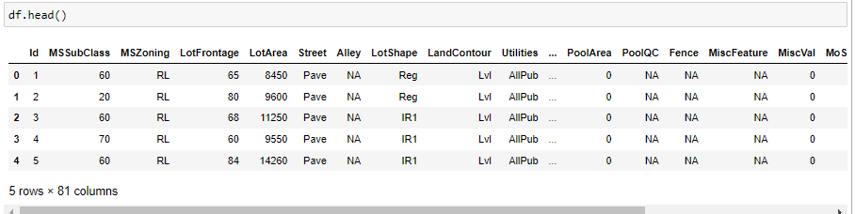
Dataset
The dataset has 1460 samples, 80 features and 1 target variable.
The target variable is the Sale Price.

Slide 6
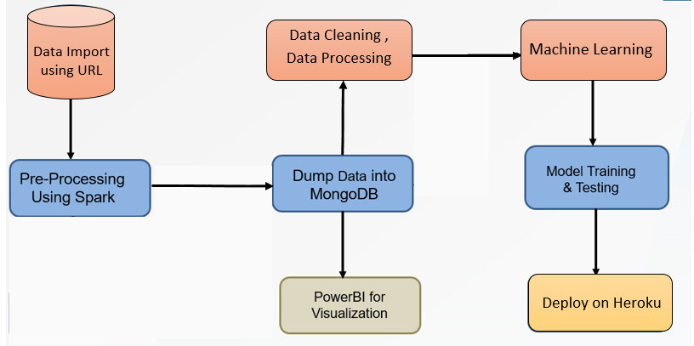
Project Life Cycle

Slide 7

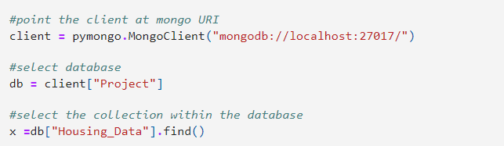
Data Import
Writing Data to MongoDB
Reading Data from MongoDB

Slide 8
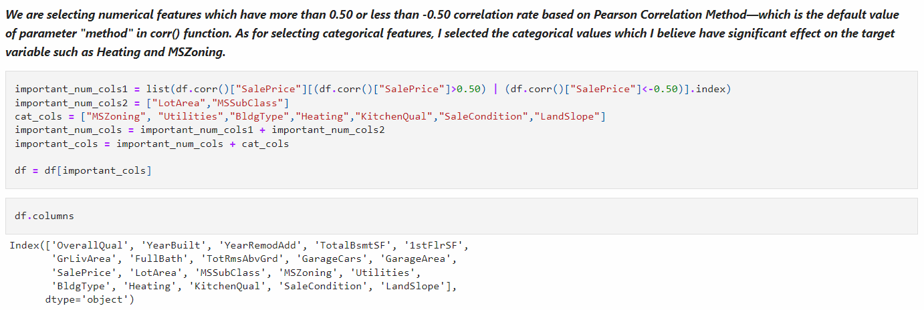
Feature Engineering

Slide 9
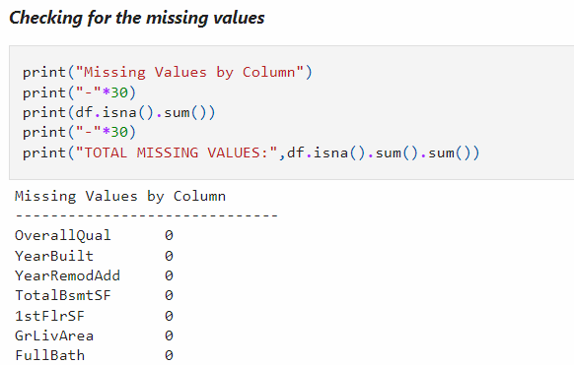
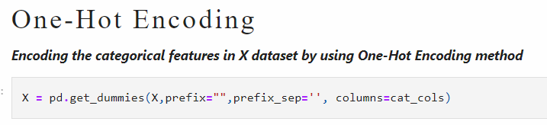
Feature Selection

Slide 10
Model Selection
Linear Regression:
Linear Regression is a machine learning algorithm based on supervised learning.
It performs a regression task. Regression models a target prediction value based on independent variables.
It is mostly used for finding out the relationship between variables and forecasting.
Ridge Regression:
It is an estimation procedure to manage collinearity without removing variables from the regression model.
In multiple linear regression, the multicollinearity is a common problem that leads least square estimation to be unbiased, and its variances are far from the correct value.
Therefore, by adding a degree of bias to the regression model, Ridge Regression reduces the standard errors, and it shrinks the least square coefficients towards the origin of the parameter space.

Slide 11
Lasso Regression:
Lasso is a powerful technique that performs regularization and feature selection.
Lasso introduces a bias term, but instead of squaring the slope like Ridge regression, the absolute value of the slope is added as a penalty term.
alpha 𝑎 is the tuning parameter which controls the strength of the penalty term. In other words, the tuning parameter is the value of shrinkage.
XGBoost Regression:
XG Boost stands for extreme Gradient Boosting.
The XG Boost library implements the gradient boosting decision tree algorithm.
Boosting is an ensemble technique where new models are added to correct the errors made by existing models.
Models are added sequentially until no further improvements can be made.

Slide 12
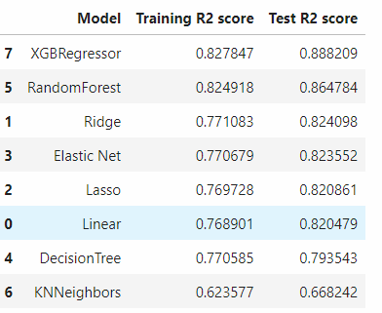
Result
R-Squared is calculated by measuring the deviations of the observations from their predicted values over the measurement of the deviations of the observations from their mean.
XG Boost made the best performance it has achieved R2 score of 0.8882

Slide 13
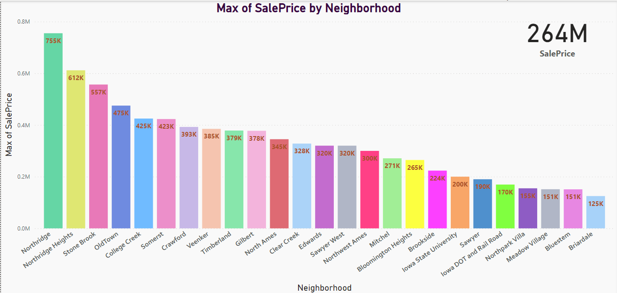
Visualization
Data visualization is the graphical representation of information and data.
By using visual elements like charts, graphs, maps, data visualization tools provide an accessible way to see and understand trends, patterns in data.
In the world of Big Data, data visualization tools and technologies are essential to analyse massive amounts of information and make data-driven decisions.

Slide 14
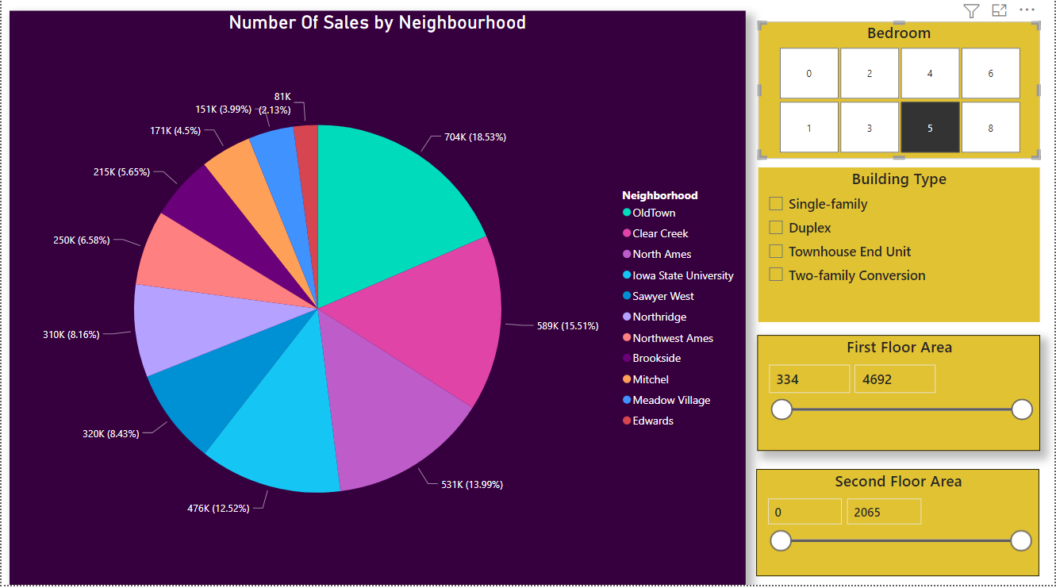

Slide 15
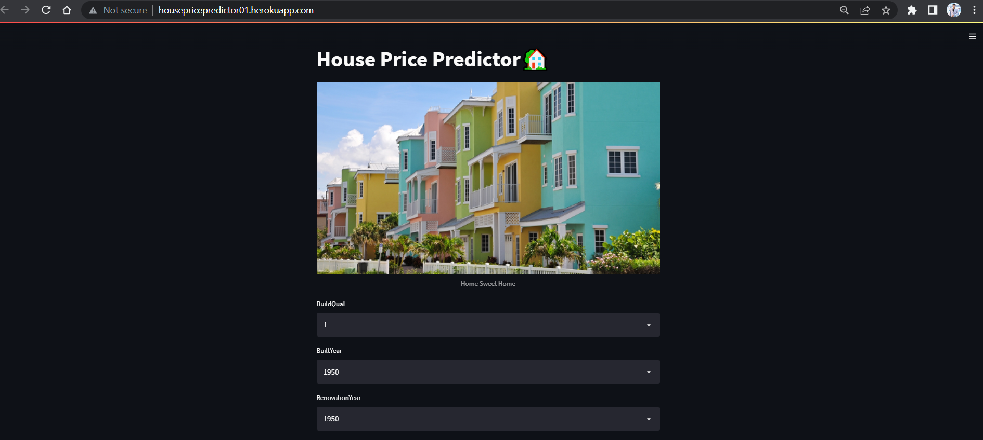
UI Based Website
http://housepricepredictor01.herokuapp.com/

Slide 16
Thank You

